Slide 1

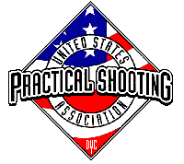
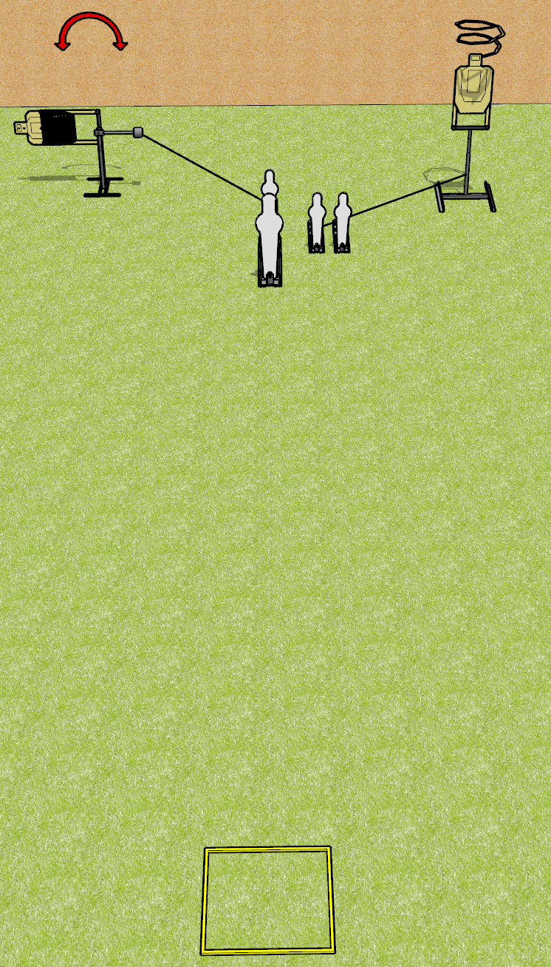
 | Dothan Gun Club – USPSA Match Some Kind of Quick Thing Course Designer : Drew Coleman
Round Count 8 rounds 2 paper 1 pepper popper, 3 mini poppers
Equipment List Swinger + activator Drop turner + activator Shooting box

Slide 2
Some Kind of Quick Thing
Written Stage Briefing
Some Kind of Quick Thing is an 8 round, 40 point, Comstock speed shoot. There are 2 USPSA targets, 1 pepper popper, and 3 mini poppers. The best 2 hits on paper will score, and steel must fall to score. The start signal is audible.
The swinger is activated by the back mini popper, and is visible at rest. The drop turner is activated by the right 2 mini poppers, and is a disappearing target.
Handgun start position is in the shooting area, wrists below belt. Handgun is loaded and holstered.
PCC start position is in the shooting area, stock on belt. Loaded carbine is held with both hands, safety on.
On start signal, engage targets as they become available from within the shooting area.

